Slide 1
Christmas Gift
How the advent of Jesus holds clues to some of Christianities hardest challenges.
Jesse Gentile
Notes:
Enjoying Rebecca McGlaughlin’s excellent 2019 book “Confronting Christianity”
It’s important to Credit McGlaugblin’s book with some of the stats/links on diversity shown here as well as inspirations for topics. The book is great and worth reading.
I’m picking through her chapter titles in this series of messages.
Isn’t Christianity a Threat to Diversity?
How Can You Say There is Only One True Faith?
How Can Christianity be True if there is so Much Evil?
Does Christianity Demean Women?
Does Christianity Support Slavery? (Is Faith in Contradiction with Science?)
Doesn’t Religion Hinder Morality? (Aren’t we better off without it?)
Let me know if you’d prefer to hear one or the other (due to time limits)

Slide 2
1. Isn’t Christianity a Threat to Diversity?
Notes:
“For many, the idea that Christianity is a white, Western religion, intrinsically tied to cultural imperialism, stands as a major ethical barrier to considering Christ. ”
* Many people in the U.S. Associate Christianity with Racism or Christianity as threat to cultural diversity at the hands of white missionaries and colonizers. - However this results from viewing Christianity from a lopsided perspective. (Yes many white Christians were racist, some still are).
Excerpt From: McLaughlin, Rebecca. “Confronting Christianity.” Apple Books.

Slide 3
Isa 42:6
Isa 49
Ex. 9:14, 16 Ps 67, 96, 117
Gen. 12:1-3
CREATION
FALL
NEW CREATION
Abrhamic Covenant
Davidic Covenant
New Covenant
Rev 5
Notes:
Luke 2:22-32 (LIGHT TO LIGHTEN THE GENTILES)
GOOD TIDINGS TO ALL PEOPLE
A LIGHT TO THE NATIONS

Slide 4
Christianity was diverse from the beginning: multicultural and multiethnic.
Notes:
Christianity began as a middle eastern non-white, non-european fiath. Initially, the only people in the church were Jewish.
Jesus parable of the good Samaritan: Breaks racial stereotypes by making the Samaritan the hero. (Lk 10:25)
Jesus conversation with the Samaritan+woman, at the well. Against Jewish custom. (John 4)
Matt 28:19 - Go make disciples of all nations. This isn’t just a Jewish religion.
First hearers in Acts 2:5-11 “Parthians (Persians), Medes (Iranians), and Elamites (Iranians); residents of Mesopotamia (Iraq), Cappadocia (Turkey), Pontus (Turkey), Asia, and Phrygia (Turkey); Egyptians and Romans.”
Acts 8 - An Ethiopian converts and is the first to bring Christianity to Africa.
Spread of Christianity in Ethiopia“Semere T. Habtemariam, “Two Slave Brothers Birthed Africa’s Oldest State Church,” Christianity Today , May 17, 2018, https://www.christianitytoday.com/history/2018/may/africa-christianity-axum-empire-ethiopian-orthodox-tewahedo.html
“Christianity took root in Egypt in the first century and spread by the second century to Tunisia, the Sudan, and other parts of Africa.”
One of the most famous and influential church fathers (Augustine of Hippo) was from North Africa
60% of the population of Sub Saharan Africa identifies as Christian.
“See “The Future of World Religions: Population Growth Projections, 2015–2050,” Pew Research Center, April 2, 2015, https://www.pewforum.org/2015/04/02/religious-projections-2010-2050/

Slide 5
“We must abandon this absurd idea that Christianity is a Western religion.”
“Christianity is the most ethnically, culturally, socioeconomically, and racially diverse belief system in all of history.”
Notes:
* Most of the world's Christians are not white or Western any more. The number of white Christians is shrinking regularly.
Bloomberg columnist “Stephen Carter has observed, that for some strange reason the secular left exhibits “an all -too frequent weird refusal to acknowledge the demographics of Christianity.”
What is the most “Christian” demographic in the US - black women.
Globally, women of color are those most likely to be Christians.
Carter implies that if you mock Christianity means you are very much mocking women of color.
“Stephen L. Carter, “The Ugly Coded Critique of Chick -fil -A’s Christianity,” Bloomberg , April 21, 2018, https://www.msn.com/en-us/money/companies/the-ugly-coded-critique-of-chick-fil-as-christianity/ar-AAwg9Dg ”
“while Sengmei deplores the ways Western culture was packaged with Christianity, she is equally clear about the positive effects of Christianization, particularly on the status of tribal women.”
Excerpt From: McLaughlin, Rebecca. “Confronting Christianity.” Apple Books.

Slide 6
Middle Eastern Religion
Notes:
Christianity was largely a middle eastern religion for centuries until Islam began military advances throughout the Middle East.
Christians from the Middle East are frequently asked, ‘When did you or your family become Christians?’ It’s hard for them not to be irritated by the question, and some of them want to answer ‘On the day of Pentecost!’ (Colin Chapman)https://journals.sagepub.com/doi/full/10.1177/0265378812439955
Iran - 1970s - estimate 500 Christians. After the 1980 Iranian revolution, oppression skyrocketed, many were disillusioned and many turned to Christianity. Hundreds of thousands have converted and Iran is perhaps the fasted growing segment of Christianity today.
“See Mark Howard, “The Story of Iran’s Church in Two Sentences,” The Gospel Coalition, July 30, 2016, https:// ​​​www ​​​.the ​​​gospel ​​​coalition ​​​.org ​​​/article ​​​/the​​​-story​​​-of​​​-the​​​-irans​​​-church​​​-in​​​-two​​​-sentences/ .
“In 1987, the Christian population of Iraq was estimated at 1.4 million (about 8 percent of the population). After the Gulf War, that number dropped dramatically. And since the rise of ISIS, some of the oldest Christian settlements have been entirely depopulated by persecution. ”

Slide 7
Christianity in India
Notes:
Most Indians are Hindu (most Hindus are Indian) - contrast to the diversity of Christianity
14% of Indians are Muslim (largest religious minority)
2+% are Christians
Hindu nationalist movement wants Christianity out = British Imperialism (Christianity = western)
However Christianity was in India BEFORE it was in Britain!
Legend of Thomas Taking Christianity to South India
“…there were well -established communities of Christians in S. India no later than the 3rd and 4th cent.” Maybe earlier.
“Robert Eric Frykenberg, Christianity in India: From Beginnings to the Present (Oxford: Oxford University Press, 2010), 115.”
Cast System In India is no longer supported and the president is from the lowest cast. Remains are strong though;
Brahmans (mainly priests and intellectuals) are believed to have come from Brahma’s (creator) head; Kshatriyas (the warrior class), from his arms; Vaishyas (traders), from his thighs; and Sudras (menial workers), from Brahma’s feet. But there was also a group below the Sudras: the Dalits, or untouchables.” From: McLaughlin, Rebecca. “Confronting Christianity.” Apple Books.
Christianity by contrast insists that all humans are equal - many of the poor made up early Christian churches, but so did the rich.
Many of Indias Christians come from the poorest class
Unfortunately Christianity also has a heritage of spreading through European colonization and Rule. Often christian missionaries moved into countries with or after European armies.

Slide 8
Christianity in Asia
Notes:
There is a “A Nestorian monument inscribed with the date 781 was discovered near Xi’an, Shaanxi, in 1623. See Kathleen L. Lodwick, How Christianity Came to China: A Brief History (Minneapolis: Fortress, 2016), 2.”
Didn’t take hold for many centuries - suddenly Christianity has exploded in China.
2010 population was estimated at 68 million
“Fenggang Yang predict that there will be more Christians in China than in the United States by 2030, and that China could be a majority -Christian country by 2050”
“Antonia Blumberg, “China on Track to Become World’s Largest Christian Country by 2025, Experts Say,” Huffpost , April 22, 2014, http:// ​​​www ​​​.huffington ​​​post ​​​.com ​​​/2014 ​​​/04 ​​​/22 ​​​/china​​​-largest​​​-christian​​​-country​​​_n​​​_5191910​​​.html .
For commentary on this, see Jamil Anderlini, “The Rise of Christianity in China,” Financial Times , November 7, ​​​201​​​4. ​​​http ​​​s://www. ​​​ft.com/co ​​​ntent ​​​/a6d2​​​a690- ​​​6545-11e4-91b1-00144feabdc0 .”
S. Korea Christians (29% of the country) are fervent missionaries. They send out the second largest
“See “Over 27,000 Korean Missionaries Ministering Worldwide, according to Study,” Christianity Daily , June 8, 2016, http:// ​​​www ​​​.christianity ​​​daily ​​​.com ​​​/articles ​​​/8179 ​​​/20160608 ​​​/over​​​-27​​​-000​​​-korean​​​-missionaries​​​-ministering​​​-worldwide​​​-according​​​-study​​​.htm .”

Slide 9
Christianity in the Americas
Notes:
We have a mixed history of Christianity in this country. There are stories of forced conversion of Indians at the hands of conquistadors. Cruelties against indians. The attempted use of the Bible to support Slavery by Christians and even using scripture.
None of those actions is actually essential or called for by Christiantiy. The Bible is one of the most anti-racist books every.
It was also Christians and primarily Christians who shifted the culture of the N. against slavery and brought it to an end (Robert Foglin one of the foremost historians on slavery - https://www.acton.org/pub/commentary/2019/04/17/secular-jew-makes-surprising-discovery-about-christians-and-american )
MLK took much of his inspiration for civil rights from the Gospels. As a Christian minister many of his messages are full of scripture.
Atheism as a worldview is most associated with white males. Christianity is being spread by other demographic groups.
Tim Keller (2017) - “The enormous energy of the churches in the global South and East has begun to spill over into the cities of North America, where a new, multiethnic evangelicalism is growing steadily. Non -Western missionaries have started thousands of new urban churches there since the nineteen -seventies . Here in New York City, even within Manhattan, I have seen scores of churches begun over the last fifteen years that are fully evangelical by our definition, only a minority of which are white”
* “Timothy Keller, “Can Evangelicalism Survive Donald Trump and Roy Moore?,” The New Yorker , December 19, 2017, https://​​​www​​​.new​​​yorker​​​.com​​​/news​​​/news​​​-desk​​​/can​​​-evangelicalism​​​-survive​​​-donald​​​-trump​​​-and​​​-roy​​​-moore.”

Slide 10
1 John 4:14 “We have seen and testify that the Father has sent his Son to be the Savior of the world…”

Slide 11
Isa 42:6
Isa 49
Ex. 9:14, 16 Ps 67, 96, 117
Gen. 12:1-3
CREATION
FALL
NEW CREATION
Abrhamic Covenant
Davidic Covenant
New Covenant
Rev 5
Notes:
(Rev 6:11) Worthy are you to take the scroll and to open its seals for you were slain and by your blood you ransomed people for God from every tribe and language and people and nation and you have made them a kingdom and priests to our God and they shall reign on the earth.
(Rev 7:9-17)
After this I looked and behold a great multitude that no one could number from every nation, from all tribes and peoples and languages standing before the throne and before the Lamb, clothed in white robes, with palm branches in their hands, and crying out with a loud voice, “Salvation belongs to our God who sits on the throne and to the Lamb!” etc…

Slide 12
In the incarnation we see God coming too all people in order to bring all the nations, not just Israel, back into God’s presence from where they had been ejected.
Notes:
ANOTHER THEOLOGICAL NUGGET - In God’s very Triune nature there is diversity and unity.

Slide 13
2. How Can You Say There is Only One True Faith?
Notes:
“Exclusivity of Christianity”
If its a genuine question that is one thing.
Claiming to be the only way to God is completely inappropriate in academic circles or in the public square.
Luke 1:26-33 “A kingdom that will never end”
No other rule, no other kingdom then.
Matthew 1:18-22 = “save his people from their sins”
Second temple Judaism in all its intensity didn’t save Israel from their sins.
Judaism became increasingly zealous for the law hoping that if they kept enough laws the messiah (Dept in Ezk) would return.
John the Baptist's message rebukes Israel.
Matthew 1:22-25 “Immanuel - God with us.”
Wasn’t God with all the faiths and religions of earth?
The answer is in Jesus name
The exclusivity of Christianity makes sense in light of the problem of humanity - we were created to live in God’s presence and we’ve been separated from God.

Slide 14
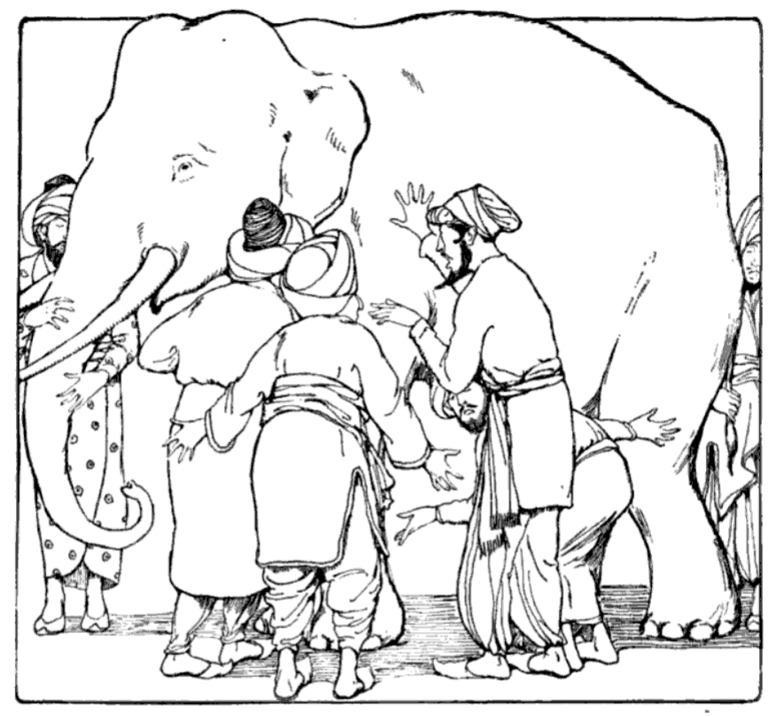
"Blind men and elephant", from Martha Adelaide Holton & Charles Madison Curry, Holton-Curry readers, 1914.
Notes:
The most famous illustration is the story of the elephant and the blind men.
Indian subcontinent, 7th century BC story.
Six blind men have never encountered an elephant. “What is it like?”
In some stories they come to blows over their disagreements.
Moral: Humans are apt to treat their own perspectives as absolute.
Assumes: that someone in the context of investigation can see everything. (i.e. knows more than everyone else that Hinduism, Christianity, Islam are all equal ways to the same truth.
Forgets: they are all right/wrong because there is in fact an absolute truth of the matter.
Arrogates: the speaker to a sort of super-meta knowledge about all faiths.

Slide 15
This criticism easily “begs the question.”
Notes:
Begging the question assumes something important to the conversation is T/F without discussing it, and carries that assumption into a secondary question.
Assumes Christianity
...IS NOT true, ...therefore… exclusivism is wrong.
...is not the only way to God...therefore
...there are multiple ways to God... therefore
Assumes that religious believes aren’t the sorts of things that are right or wrong; true or false. (I.e. Antirealism) - expressivism….therefore

Slide 16
The “exclusivism-is-wrong” charge is just another way of making another exclusive truth claim.
Notes:
We are still faced with the same task - which claim is true?
2016 “post-truth” Oxford Dictionary’s word of the year.
Signaled an environment where truth became irrelevant due to appeals by politicians in the UK/US to emotion, rumor, and conspiracy.
We are more obsessed than ever with truth… in many ways (rightly).
WHY?
Nearly impossible to escape truth because the natural understanding of truth (i.e. correspondence theory of truth) is just another way of saying that what we believe/claim is what matches the real world around us.
We are just disagreeing about reality, with two different claims and we still have to do the work of discovering which has more warrant.
The truth that “No one religion matches reality better than others” - is exclusively true and everyone should submit to it instead.

Slide 17
2. Many people are exclusivists about moral/ethical truth.
Notes:
We are being arbitrary in picking which parts of the world we want to treat as real and which we want to treat in an antirealist way:
When it comes to issues like racism, non consensual sexual activity, torture or political corruption suddenly we care very much to say that it is true that racism and sexual abuse is flat wrong. It’s not—merely—one culture’s opinion about the world.
We might say - oppressed or undeveloped minority cultures w/o access to modering information get a free pass - but are ultimately wrong.
In Oct 2017,—multiple sexual abuse allegations against Harvey Weintein, the #metoo movement was born. Thousands (unfortunately) and millions of women internationally use the hashtag to signal sexual abuse by powerful men in their lives.
We commend these women, for being brave (will anyone believe me), and presumably because they have told the truth… not just “her truth.”

Slide 18
3. Attacking exclusivism attacks every conversion from one faith to another.
Notes:
It also denies something rather obvious about several major world faiths:
(a) The millions of people that have changed religious or ethical positions have done so because they thought they had good reasons.
(b) Most of the major world religions are exclusive because they make contradictory statements about the fundamental nature of reality.
The world isn’t two ways at once.
Hinduism = there are hundreds of thousands/millions of God’s. Islam = there is one God.
Judaism = Jesus is not the Messiah. Christianity = Jesus is the Messiah
Jainism = don’t kill/eat any creature (even eggs).
Atheism = there is no God (or no evidence for any gods), Most religions = there is at least one God.

Slide 19
4. Attacking exclusivism attacks every intellectual move from on faith to another.
Notes:
It also denies something rather obvious about several major world faiths:
(a) The millions of people that have changed religious or ethical positions have done so because they thought they had good reasons.
(b) Most of the major world religions are exclusive by default because they make contradictory statements about the fundamental nature of reality.
The world isn’t two ways at once.
Hinduism = there are hundreds of thousands/millions of God’s. Islam = there is one God.
Judaism = Jesus is not the Messiah. Christianity = Jesus is the Messiah
Jainism = don’t kill/eat any creature (even eggs).
Atheism = there is no God (or no evidence for any gods), Most religions = there is at least one God.

Slide 20
What the “answer” is depends on what you think the problem is.
Notes:
If you think “religion” is just cultural expression…
… assumes this isn’t really about God, or its about a global god spirit or something inherent in all of us.
These are all claims that should only be believed with evidence. What if religion is more than cultural expression? What if the expression of a deep seated desire and longing for a God who is really there? Expression of a separation.

Slide 21
5. Don’t equate disagreement and disrespect. Jesus disagreed with a lot of people.
Notes:
Someone has said, “Respect ideas.”
Someone else, “no respect, people, not ideas.”
I suggest, “We respect people and ideas (don’t blow them off as stupid)
This has nothing to do with whether or not they are true.
Most belief systems have a ring of coherence and their own evidence base. They have a sort of strength to explain many or few parts of the world. And that is what makes them powerful in captivating ways. And dangerous if they aren’t true.
RICH YOUNG RULER - Exclusivism (Mark 10:17ff)
We can’t be good enough to enter life
We are broken; sin prevents it.
This is ultimately about IDOLATRY - no other gods!

Slide 22
6. Jesus did not teach there were multiple ways to God.
Notes:
Jesus claimed he was the only way to God the father
John 14:6 I am the way, the truth and the live, no one comes to the father but through me.
Jesus claimed exclusive religious authority
“All authority in heaven and on earth has been given to me. Go therefore and make disciples of all nations, baptizing them in the name of the Father and of the Son and of the Holy Spirit, teaching them to observe all that I have commanded you” (Matt. 28:18–20 ).”
Jesus claimed that if people did not believe he was the messiah they would die in their sins (John 8:24)
But the gospels are testimonies that Jesus backed his claims up with radical love, care for the poor/outcast/disempowered, healings, resurrections, power of nature and claims to be one with the God the father.

Slide 23
In the garden Jesus asks God if there was any other way. There was not. The incarnation is the only answer to humanities separation from God.
Notes:
In Christ God comes as close as possible to humanity - He takes human nature to Himself. How would we really know the transcendent God could be related to?
On the cross, he takes our sin on himself. How would we really know God accepted us and wasn’t angry?
In the grave he takes our death and dies it for us.
Then he rises and again promises to personally take us back to dwell with God.

Slide 24
Does Exclusivism Require Certainty?
Notes:
Believing one view is true and others are false doesn’t require certainty.
It just requires the belief there is better evidence.
This would be no different than believing the evidence of a court case was beyond reasonable doubt. It’s not certainty but its strong enough to rule out other theories. We regularly believe without certainty.
We can’t have absolute certainty: You weren’t secretly switched at birth or that you don’t have a sibling you've never met. That the world wasn’t created 5min ago.
You can have a high degree of justification for an inference that one religion or worldview makes better sense of all the evidence, discoveries, and so on.
Something rather than nothing exists.
Finely tuned universe - and our location in the universe to detect it
Humans as artists, investigators, caretakers, storytellers
Presence of sacrificial and altruistic love
The appearance of consciousness from matter
Deep moral sense that pervades humanity & that we should be moral.
Historical evidence for the resurrection.
That thousands of religiously fastidious monotheists started worshipping a man named Jesus and believing in the resurrection of one individual in the middle of history.
That Jesus wasn’t a crazy - or worse - sane and still staying what he did.
Don’t get me wrong… you CAN tell other stories to make sense of this, but that story make not make the best sense.

Slide 25
3. How Can Christianity be True if There is So Much Suffering?

Slide 26
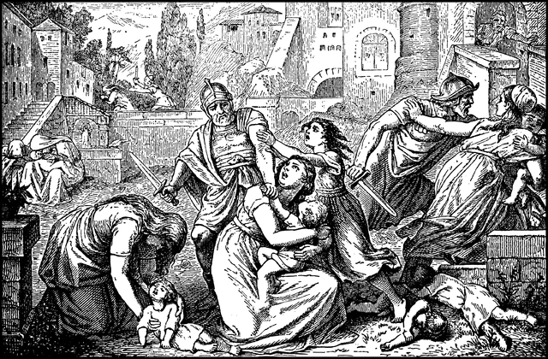
Genocide
Is in the Christmas Story
Notes:
Matthew 3:16-18 - Weeping was heard in Ramah.
Luke 2:22-35 A sword will pierce your heart
Eventually every son of Bethlehem was killed (even Jesus). God’s son died too.

Slide 27
Why is Rachel heard weeping in Ramah? Over the slaughter of children in Bethlehem?
Notes:
11 miles distance between Ramah and Bethlehem
Gen 35:16-20 Rachel dies giving birth to Benj. on the road from Bethel to Bethlehem
1 Sam 7:17 Ramah is close to much of Samuel’s prophetic activity
1 Samuel 10:2, in which Samuel tells Saul that he will meet two men at Rachel’s Tomb shortly after he leaves the town (of Ramah). This would seem to indicate that Rachel actually died in the vicinity of Ramah.
Jer 31:15-17 Rachel weeping (Jer 40:1 Ramah is a departure for captives to Babylon) as she watches her children depart to captivity from the place she is buried.
There is hope in Jeremiah 31:16-17 of a restoration.
Matthew 2:18
Herod the oppressor (reminder of sin and exile) dies
Jesus, like Israel, returns from Egypt, the land of captivity to Israel to save his people.

Slide 28
Logical Problem of Evil
Evidential Problem of Evil
Natural Evil
Moral Evil
Notes:
You can’t address the problem of evil simply with philosophy - because it is so emotionally painful. We need the gospel as well.

Slide 29
The Logical Problem
If God is all good he wants to stop evil.
If God is all powerful he can stop evil.
There is evil.
There is not an all powerful and all good God.
Notes:
Most philosophers don’t use the logical problem any more. Atheist philosopher Paul draper notes that some serious attempts have been given to argue for God’s non existence from the logic problem. However, arguments like those of philosopher Alvin Plantinga have convinced many people that this is a mistaken argument.

Slide 30
Omniscience
Notes:
An all knowing God could have reasons for allowing evil
There are certainly all sorts of reasons God could have for allowing evil.
Maybe God ran all the scenarios. It may not have been logically possible to have a world, with genuine human agency, without the possibility for evil.
Even if God created a perfect world it might have always gone this way.
Why? Just as God is the source of life and can’t make us the source of life, perhaps God alone is the source of goodness, and no one else can be created inherently good like God. It may just not be possible.

Slide 31
Evidential Problem
Notes:
This assumes that divine care and indifference is captured in God stopping evil right now in history. This sort of mistakes the problem for the symptoms.

Slide 32
2. In the story of humanity we get to see what we really are as a race ‘on our own.”
This is really us...
Notes:
Scriptures proclaims that humans are depraved.
Jeremiah 17:9; Mark 7:21-23; John 3:19 ;Romans 3:10-12 ;Romans 5:6 ; Romans 6:16-20; Ephesians 2:1-3; 1 Corinthians 2:14
We consider ourselves more advanced that primitive ancestors but more people have died in the 20th century than any other. Technology has magnified the depravity of humanity.
Was what the Nazi’s did inhumane? It was all too human.
Japanese did horrific things to the Chinese during WW2 - Nazi leader John H. Rabe intervened to put a stop to it. (This was very human)
Russians who marched into Germany at the end of WW2, engaged in rape, deliberate starvation of children, horrific murders in front of families and things inappropriate to mention here. (Very human)
Ruwanda 1994 (800k) torturned, raped and murdered
1.2mil Armenians murdered by young Turks 1915-1923
1975-1979 2 million Cambodians were murdered
Guatemala, thousands of Mayan indian descendents were murdered
Reconciliation commission of S. Africa found found over 36,000 rape, murders, tortures and killings.
Roughly 20 million African’s were taken from homes to be sold as slaves. Most died before they even made it across the middle passage; those that did, weren’t saved but lived lives of slavery.
This goes on and on.
It occured over and over, DR Congo, ISIS/Taliban, Sadaam Hussein’s IRAQ, British empire in Tasmania, the
In every continent, in every century we find rape, genocide, war, massacres. The ancient world, from Babylon, Persians, Greeks, Romans… this is what humans do.

Slide 33
Just going along...
Notes:
It is like that most of the people who committed these acts were just going along with the policies and practices of other humans. Dislike of “the other” fueled justification for seeing them as other and eradicating them. Katz argues that it was “ordinary” people that carried out the policies of Hitler, Mau, turned a blind eye. It doesn’t take many steps before we engage in the same

Slide 34
Notes:
Langon Gilkey used to believe in the innate goodness of humans until he was placed in a concentration camp. “Nothing indicates so clearly the fixed belief in the innate goodness of humans as does this confidence that when the chips are down, and we are revealed for what we ‘really are’ we will all be good to each other. Nothing could be so totally in error. . (p92)
In the western world we have most of our basic needs met, even the poor...so we don’t have to face the horrific reality of invading warlords from across the river. Our capacity to kill and harm each other is very much a part of us.

Slide 35
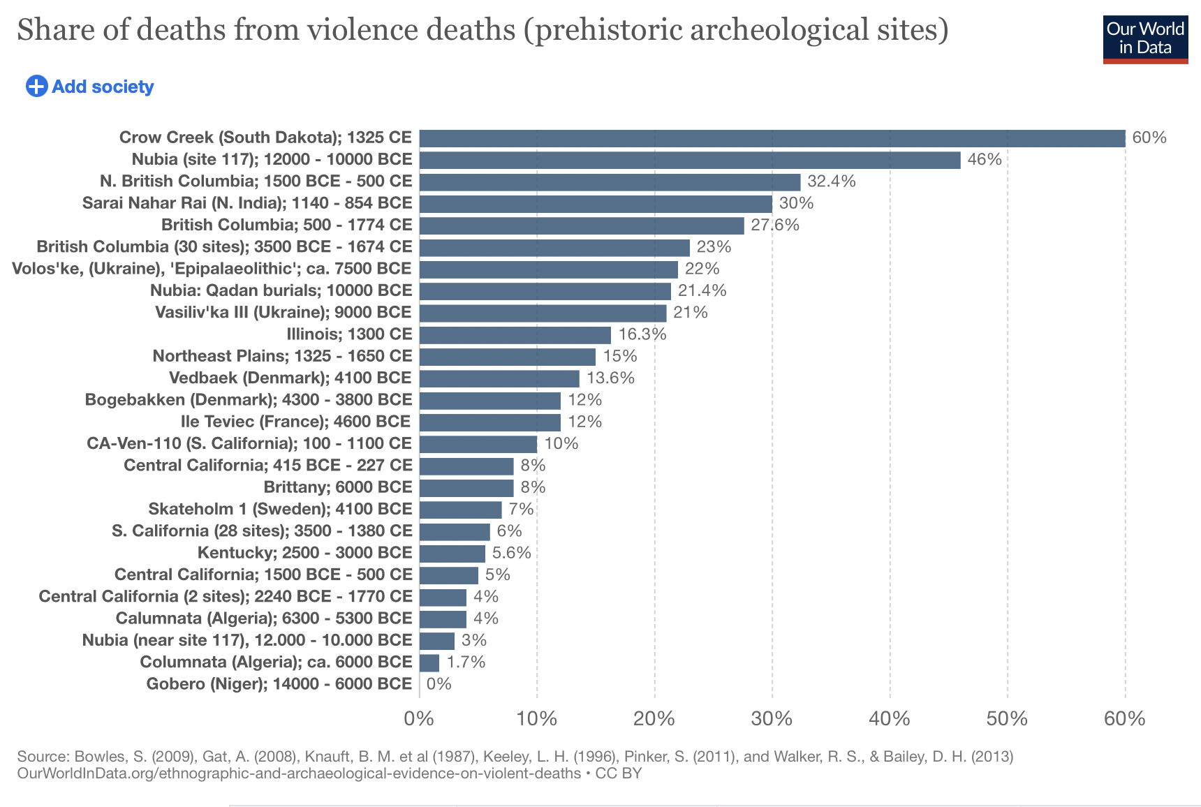
Notes:
Antedeluvian violence. Murder rate in prehistoric times was much higher than we might think. The idea that modern society has corrupted modern humans is not accurate. Humanity always has and still has this capcity.

Slide 36
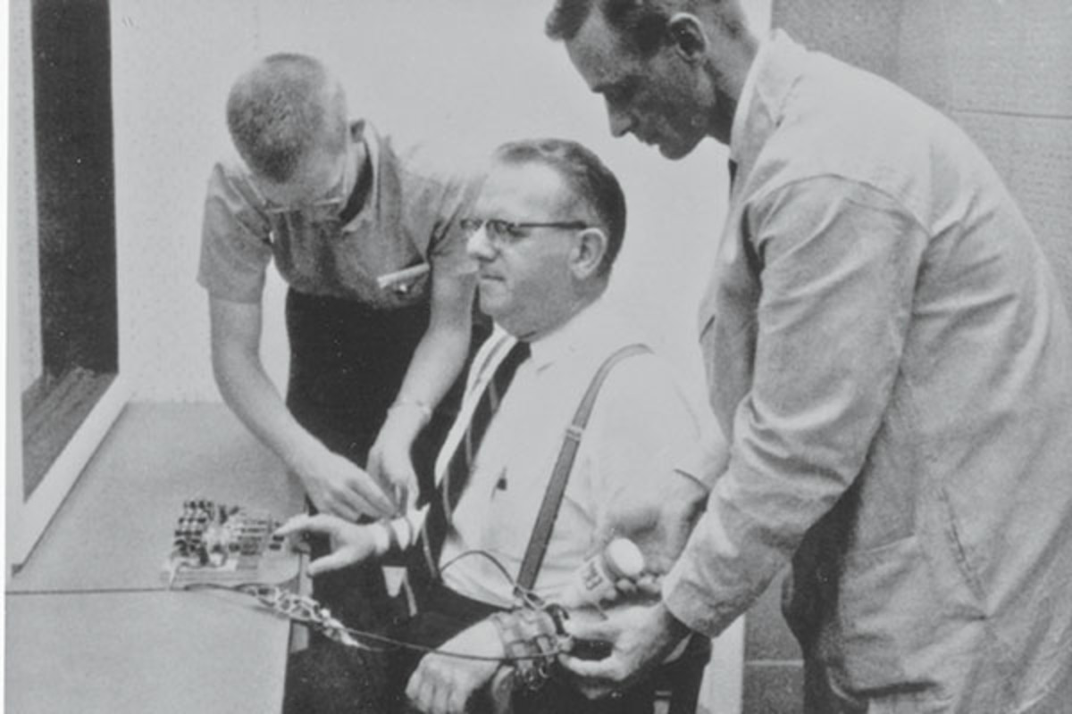
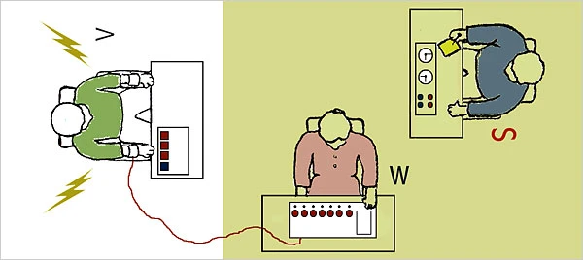
Stanley Milgram experiments
Notes:
Volunteers who signed up for the experiment , were told to shock another person (an actor) if they answered a question wrong. As long as the scientist told them to issue the shock they were willing to do so. In very high cases this included a shock that could possibly kill the “patient”. This experiment has been confirmed multiple times with even higher rates.

Slide 37
Why don’t more people commit crimes? Story of the first humans without consequences.
Notes:
They certainly word, but don’t due to self protection and interest. Due to self interest. Cain, Lamech (when there are no laws)
Humans are capable of some good things; that is the result of the image of God in us. We aren’t as evil as we could be. But there is deep capacity for evil in all of us. Human government and restraint of evil is a grace of God.
Cases that will not bring us notariety, and could truly cost us—but that are right—are less common.

Slide 38
Romans 3:10-12
Notes:
None are righteous no-not one.
Jesus doesn’t present humans as misguided that just need a little help. We are sinners that need to admit the truth about ourselves and turn to God for help.
Looking at the race as a whole, and our history, what does the evidence imply?
Christianity holds that there are no good people that bad things happen to. Just bad people whose sin you can’t see in the moment, and who if the tables were turned would and could do similar things.

Slide 39
3. We mistakenly assume the best answer is to buffer our circumstances without fixing us deeply within.
Notes:
Again it may not be logically possible to allow people to be fully human agents (who can image God) and constantly stop them at every turn from doing what they would do if God didn’t stop them.
Jeremiah 31 says we need new hearts; we can’t follow God’s law without that.

Slide 40
4. God is the only one ultimately doing anything. Covenant.
God gets personally involved: incarnation.
Notes:
In the history of scripture God comes into the story time and time again.
God comes to Bethlehm, Ramah.. In christ God is personally in the story now… fleeing for his own life.
Here we see the beauty of the Trinity - and incarnaton.
John 11 - Jesus lets lazarus die so he can come stand with Martha, Mary at the tomb and say “THE ANSWER IS NOT PREVENTING EVIL, ITS RESURRECTION”

Slide 41
5. His name isn’t just Immanuel, it’s Jesus.. he will save his people from death by saving them from sin .
Notes:
Ultimately why do we die? Because we are cut off from the source of all of life. God To undo death we must be reunited to God - and that won’t happen without cleansing us from sin, freeing us from the guilt of sin, changing our hearts from within.

Slide 42
The problem of suffering is the pain of loss; being alone, losing those we love; the fear of death’s victory. God comes to be with us, to go with us, and undo the loss, & victory.
Notes:
1 Cor 15:55-57 Oh death where is your sting, grave where is your victory.
If you had 10 lifetimes to rebuild what you lost it wouldn't be so bad - but you don’t.
If you knew those who died would come back to life (or wouldn’t die) war would not be so bad (more like a riot)
If we were surrounded by loved ones, loss wouldn’t be so bad.

Slide 43
Jesus prayed multiple times about the possibility of not drinking the “cup” of the cross. We hear no answer from heaven.
Notes:
Willing to do it does not equal WANT to do it.
That weekend, Jesus friends were too tired to be with him in his pain. One of his close friends went out and committed suicide. His friends ran in his hour of need. One of his closest three friends completely denied him in public. The crowds that had followed him voted for his death. The moral leaders of the nation insisted he was a fraud. The government traded justice for a holiday tradition.

